Slide 1
Calculating Family Expenses Using Service Now
SlideMake.com

Slide 2
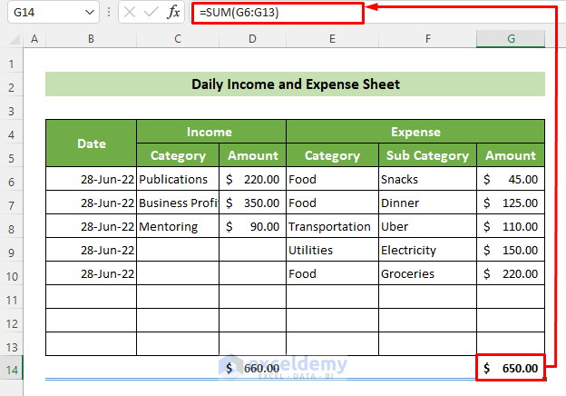
Introduction to Calculating Family Expenses with ServiceNow
ServiceNow is a versatile platform that can be tailored for personal finance management.
It allows families to track and analyze their expenses efficiently.
This presentation explores how to leverage ServiceNow for effective family expense calculation.
Notes:
Image source: https://www.exceldemy.com

Slide 3
Benefits of Using ServiceNow for Family Expenses
Centralizes all financial data in one accessible platform.
Automates expense tracking and reporting processes.
Helps families identify spending patterns and areas for savings.
Notes:
Image source: https://www.servicenow.com

Slide 4
Setting Up Your Family Expense Dashboard
Create custom tables and fields relevant to family expenses within ServiceNow.
Use the form builder to design user-friendly interfaces for data entry.
Organize the dashboard to display key financial metrics at a glance.
Notes:
Image source: https://s3-alpha.figma.com

Slide 5

Inputting Family Expenses into ServiceNow
Encourage family members to regularly record their expenses through simple forms.
Use categorized fields for different expense types like groceries, bills, or entertainment.
Automate recurring expense entries for consistent costs to reduce manual input.
Notes:
Image source: https://img.freepik.com

Slide 6
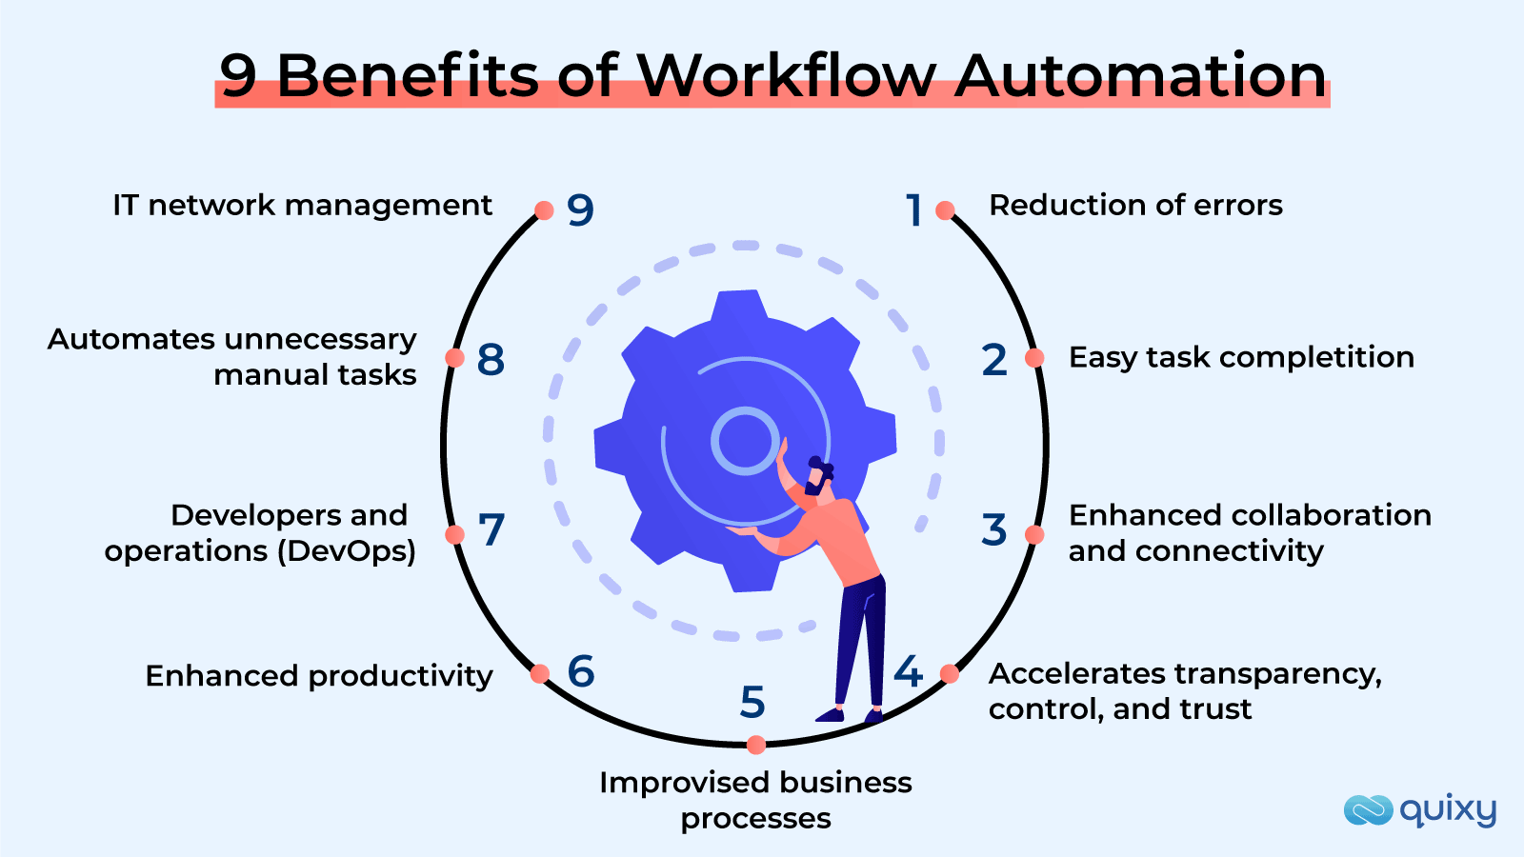
Automating Expense Data Collection
Integrate bank account feeds or financial apps via ServiceNow integrations.
Use scheduled data imports to keep expense records up-to-date.
Minimize manual effort and improve data accuracy through automation.
Notes:
Image source: https://quixy.com

Slide 7
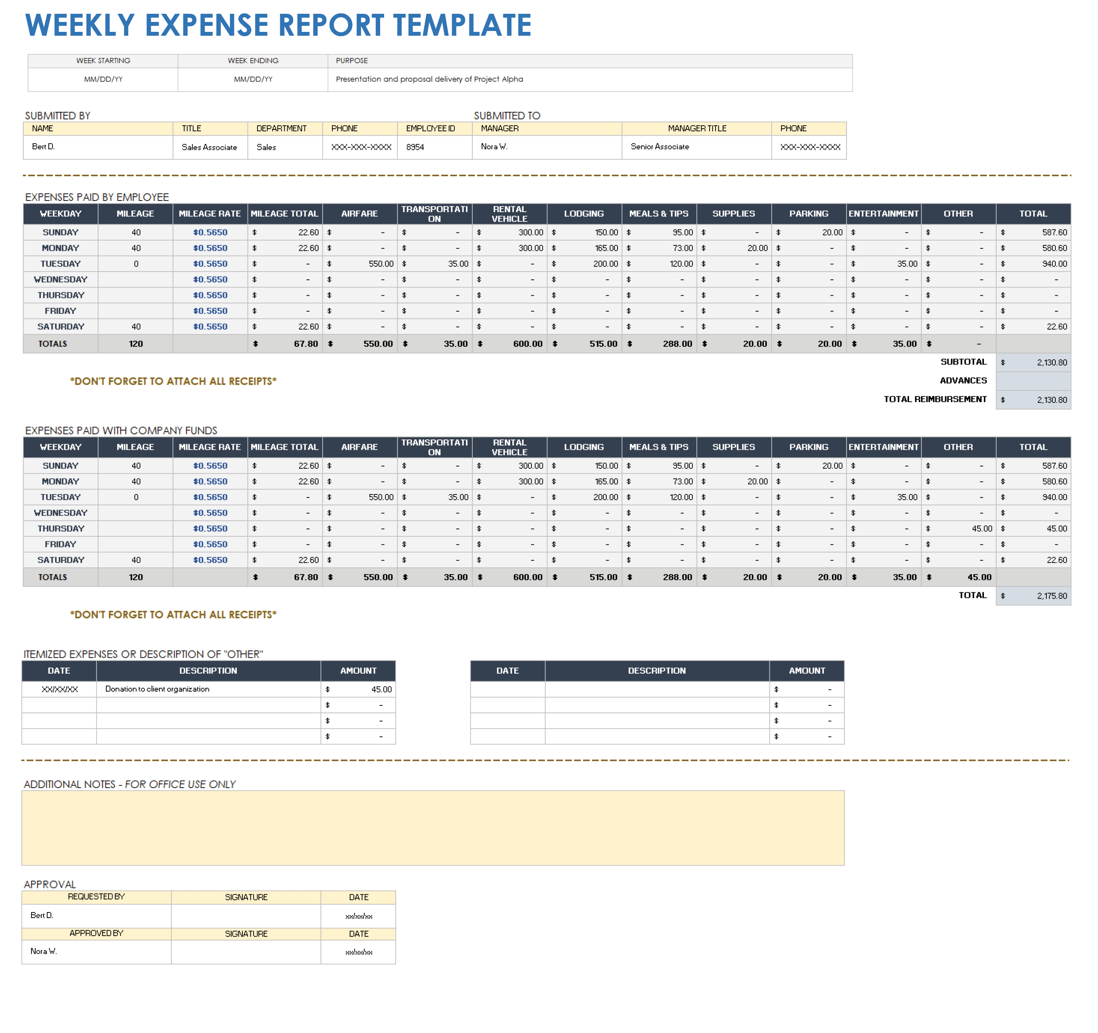
Analyzing Expenses with Reports and Dashboards
Generate real-time reports to review spending trends over specific periods.
Customize dashboards to visualize expenses by categories, family members, or timeframes.
Use these insights to make informed budgeting decisions.
Notes:
Image source: https://www.smartsheet.com

Slide 8
Calculating Total Family Expenses
Use ServiceNow's calculation functions to sum expenses across categories and periods.
Create formulas or scripts to automatically update total expenses as new data is entered.
Analyze the totals to assess whether spending aligns with the family budget.
Notes:
Image source: https://www.exceldemy.com

Slide 9
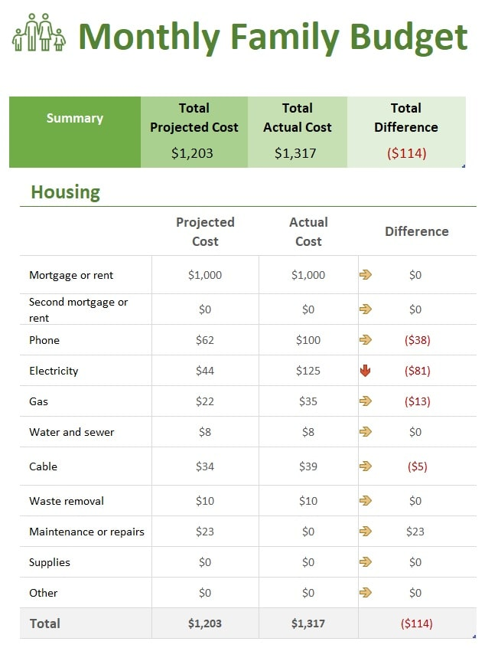
Budget Planning and Expense Forecasting
Set budget targets for each expense category within ServiceNow.
Use historical data to forecast future expenses.
Adjust budgets dynamically based on actual spending trends.
Notes:
Image source: https://techguruplus.com

Slide 10

Sharing and Collaborating on Family Finances
Enable role-based access controls for family members to view or edit financial data.
Share reports and dashboards via ServiceNow portals or email notifications.
Promote transparency and collective decision-making on family expenses.
Notes:
Image source: https://thumbs.dreamstime.com

Slide 11
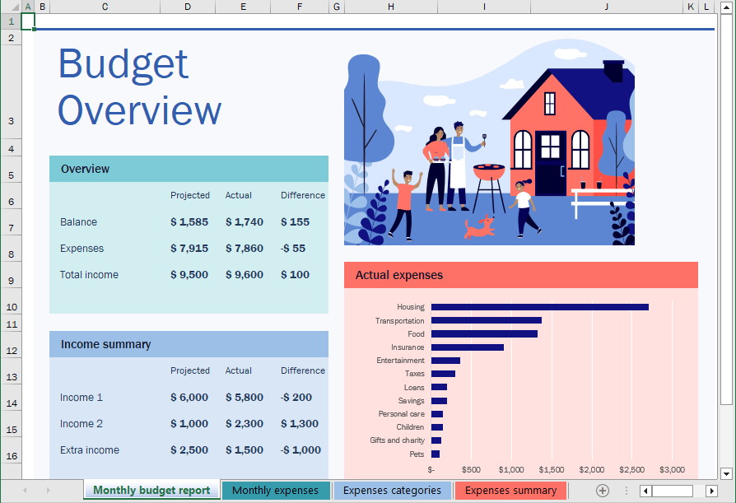
Conclusion and Next Steps
Leveraging ServiceNow simplifies family expense management and promotes financial awareness.
Start by customizing your dashboard and inputting initial expense data.
Regularly review reports to maintain a healthy family budget and identify savings opportunities.
Notes:
Image source: https://www.officetooltips.com

Slide 12
References
ServiceNow Documentation and Resources.
Personal Finance Management Best Practices.
Community Forums and User Guides for ServiceNow Customization.

